Slide 1




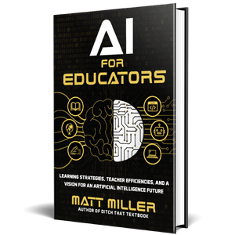

Classroom
AI use:
What's
CHeating?
WHat's OK?
More AI
Creation
AI does student work for them with no thought by the student
AI writes content but student edits it based on learning from class
Student re-writes AI-generated content with own improvement ideas
AI generates multiple drafts; student chooses best parts of AI drafts
Student writes bullet points to include but AI writes the draft
AI guides student through writing process as a "writing coach"
Student creates content until stuck; asks AI for help to get "unstuck"
Student writes a draft; AI writes a draft; student adds best AI ideas
Student gathers stats/research via AI but creates all content on own
Questions to ask:
What's OK? What's not? For whom?
For what work? Under what circumstances?
What work best prepares students for THEIR future?
Where do you draw the line for your students?
At what point is it student's work and no longer AI?
Student consults internet/AI for writing ideas but creates content on own
Student writes all content but asks AI for feedback to improve
More Human
Work
Student does all work without any assistance from AI , the internet, etc.
Graphic created by Matt Miller of Ditch That Textbook.
For more, visit DitchThatTextbook.com/ai-cheating

Slide 2
Classroom
AI use:
What's
CHeating?
WHat's OK?
More AI
Creation
aaa
aaa
aaa
aaa
aaa
aaa
aaa
aaa
aaa
Questions to ask:
What's OK? What's not? For whom?
For what work? Under what circumstances?
What work best prepares students for THEIR future?
Where do you draw the line for your students?
At what point is it student's work and no longer AI?
aaa
aaa
More Human
Work
aaa
Template created by Matt Miller of Ditch That Textbook.
For more, visit DitchThatTextbook.com/ai-cheating

